Slide 1
Python and MySQL
Web Programming
Topic 8
Readings:
Chapter 14
CS319

Slide 2
TOPICS
HTML
Python
  MySQL API for Python
  Flask web framework for Python
CS319

Slide 3
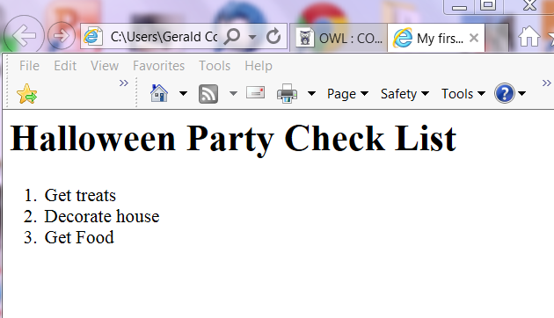
Webpages - HTML
Webpages written in HTML
HTML tags (usually sets of two: opening tag and closing tag)
To do assignment 3 you need to know a bit of html
Example: halloween.html
<!DOCTYPE=html>
<html>
<head>
<title>My first webpage</title>
</head>
<body>
<h1>Halloween Party Check List</h1>
<ol>
<li>Get treats</li>
<li>Decorate house</li>
CS319

Slide 4
More on HTML
Main things you can do with html:
  Format (make headings, paragraphs, lists)
    <h2>A pretty big heading</h2>
  Create links →
    <a href=“http://www.uwo.ca”>Click Here</a>
  Add images →
    <img src=“http://uwo.ca/dog.jpg” width=“200”>
  Add objects like:
    Text boxes →
      <input type = "text" id = "myText" value = "text here" />
    Buttons (Radio, Checkbox, etc)
      <button type="button“ id=“but1”>Click Me!</button>
CS3319

Slide 5
Html review
Tags – usually opening and closing:
  E.g. <html> and </html>
  <ol> and </ol>
  <li> and </li>
Close tags in a nested manner:
<p>This is a <b>paragraph</b></p> NOT
<p>This is a <b>paragraph</p></b>
If no closing tag, then put a / at the end, e.g.
  <img src=“http://www.uwo.ca/cat.jpg” width=“100” height=“200”/>
CS3319

Slide 6
Html review
First 2 tags are:
<!DOCTYPE html> (tells what version of html)
<html>
Last tag is </html>
There are 2 sections: head and a body:
<!DOCTYPE html>
<html>
<head>
<title>A simple page</title>
</head>
<body>
<h1>My first web page</h1>
<p>another paragraph</p>
</body>
</html>
CS3319

Slide 7
Html review
Just creates static pages (can’t check if the user entered incorrect data like an invalid phone number… JavaScript can do this)
EXERCISE: Create a file in a text editor with the extension .html
  E.g. house.html
  If it will be the first(home) page, call it index.html
  Make it have one link, one image, one heading and one paragraph
CS3319

Slide 8
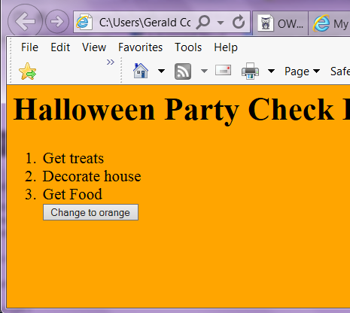
Add a little JavaScript:
http://www.csd.uwo.ca/~lreid/cs3319/examples/halloween.html
There is a missing tag below, can anyone see it!
<!DOCTYPE=html>
<html>
<head>
<title>My first webpage</title>
<script>
function makeScary() {
document.body.style.backgroundColor="orange";
}
</script>
</head>
<body>
<h1>Halloween Party Check List</h1>
<ol>
<li>Get treats</li>
<li>Decorate house</li>
<li>Get Food</li>
<button type="button" onclick="makeScary()">Change to orange</button>
</body>
</html>
CS319

Slide 9
More on JavaScript
JavaScript and HTML run on the client’s machine
Thus, a webpage written with just HTML and JavaScript can’t read/write from a database because the database is NOT on the client machine.
We need a way to get data from the database on the server.
Need a server-side scripting language like Python
CS319

Slide 10
Python
First developed in the late 1980’s by Guido van Rossum
One of the top programming languages in the world
  http://www.tiobe.com/tiobe-index/ (5th)
  http://githut.info/ (3rd)
  http://spectrum.ieee.org/computing/software/the-2016-top-programming-languages (3rd)
CS3319

Slide 11
Python
The Zen (philosophy) of Python
  https://en.wikipedia.org/wiki/Zen_of_Python
  Beautiful is better than ugly
  Explicit is better than implicit
  Simple is better than complex
  Complex is better than complicated
  Readability counts
  …
Python was designed to be highly extensible.
CS3319

Slide 12
Python
Syntax
  Simplicity and readability is very important
  Here are 3 Hello World! Programs (C, Java, Python)
#include <stdio.h>
main( )
{
printf("hello, world\n");
}
public class HelloWorld
{
public static void main(String[] args)
{
System.out.println("Hello world!");
}
}
print("Hello world!")
CS3319

Slide 13
Python
Python uses whitespace indentation to delimit blocks - rather than curly braces or keywords.
Compare
Size of indentation doesn’t matter, but it has to be consistent
if ( a > b )
{
a = b;
b = c;
}
if a > b :
a = b
b = c
CS3319

Slide 14
Python
Python does not use a semi-colon to signify the end of a statement. Python uses the new line
Compare
The left statements are valid in Java, the right statement is not valid
a = b; b = c;
a = b b = c
CS3319

Slide 15
Python
Python is a dynamically-typed language
This means you do NOT declare what type the variable is, your program just needs to know how to deal with it when it uses the variable
Compare
The Java code on the left will throw an exception. The Python code will carry on
int a = 1;
int b = 2;
int c = a + b;
c = “String”;
a = 1
b = 2
c = a + b
c = “String”
CS3319

Slide 16
Python
Other notes
  Comments are signified with #
  No compiling. To run your Python program, just type:
  python3 programName.py
  Helpful links
    http://docs.python.org/3/tutorial/
    http://pythontutor.com/
    https://learnxinyminutes.com/docs/python3/
    https://www.reddit.com/r/learnpython/wiki/index
CS3319

Slide 17
Python + MySQL
You could write an entire library in Python to interact with MySQL or …
Python has a MySQL API
  http://dev.mysql.com/doc/connector-python/en/
CS3319

Slide 18
Python + Web programming
You could write an entire web server entirely in Python or …
Python has a popular Web Framework called Flask
  http://flask.pocoo.org/
CS3319

Slide 19
Python + Web programming
Python runs on the server machine (where the webpage originates and the database resides)
Any Python code runs before the webpage is displayed to the user
As soon as the page is displayed (finished loading), you can no longer run any of the initial Python code.
CS3319

Slide 20
Assignment 3
Put it all together
  HTML
  Python
    MySQL API for Python
    Flask web framework for Python
Then you will have all the skills you need to do assignment 3.
CS3319

